Slide 1
How do life experiences affect pro athletes' performance?
Ying Ma
3/20/2018

Slide 2
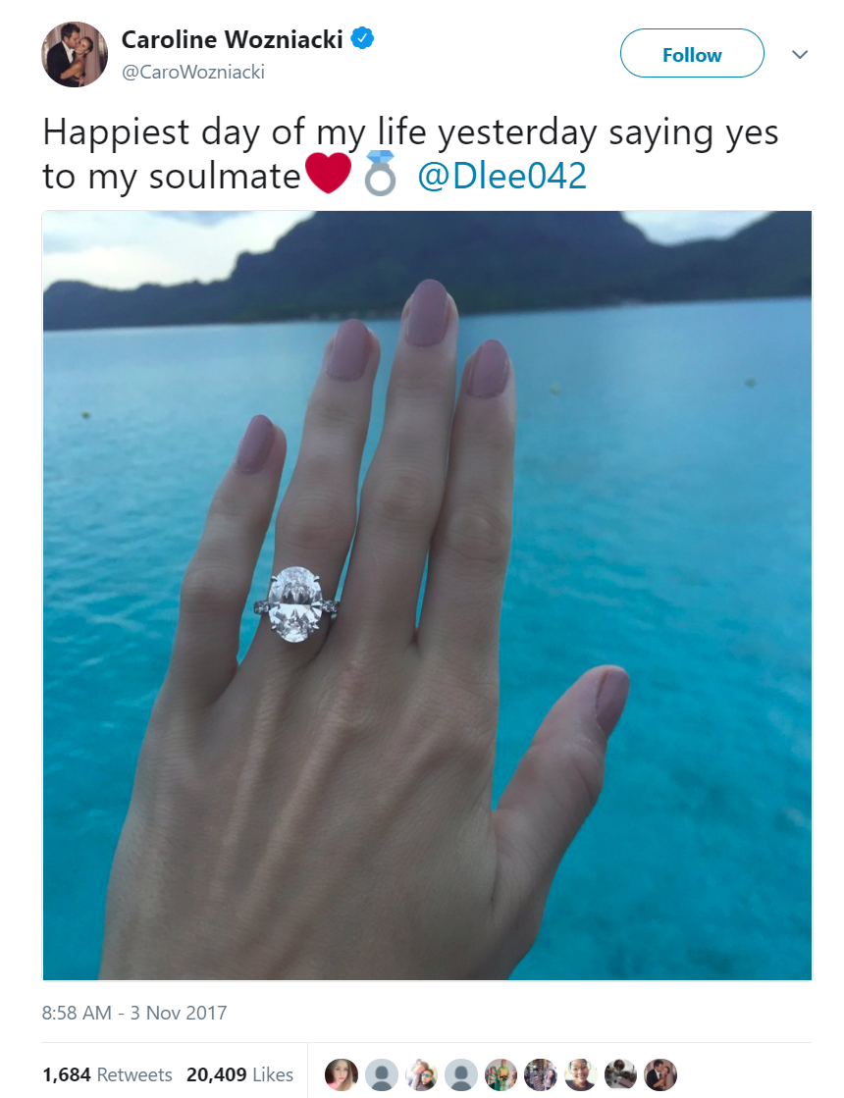
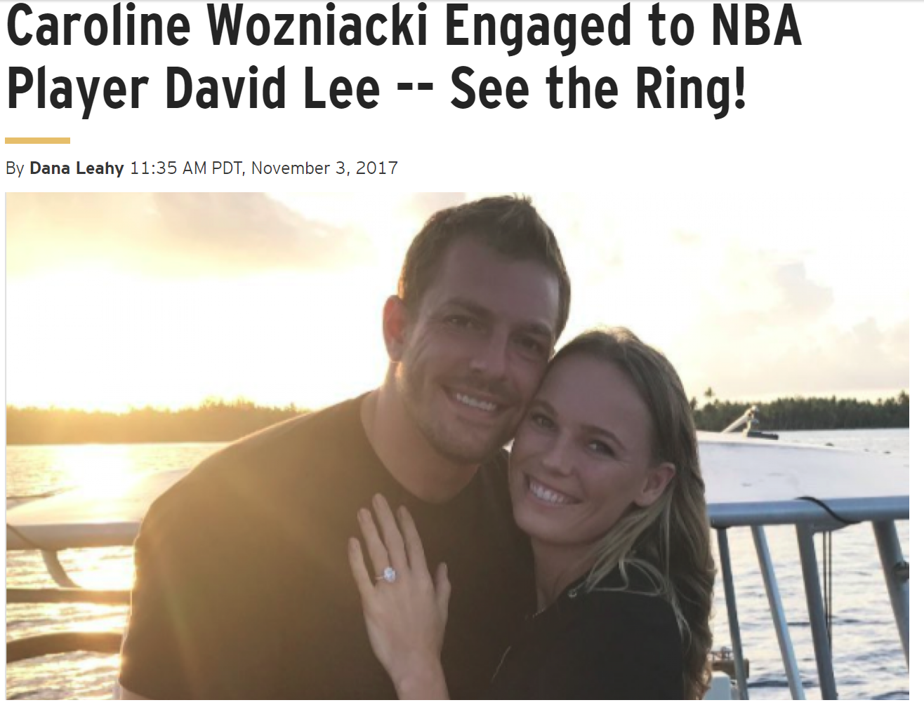
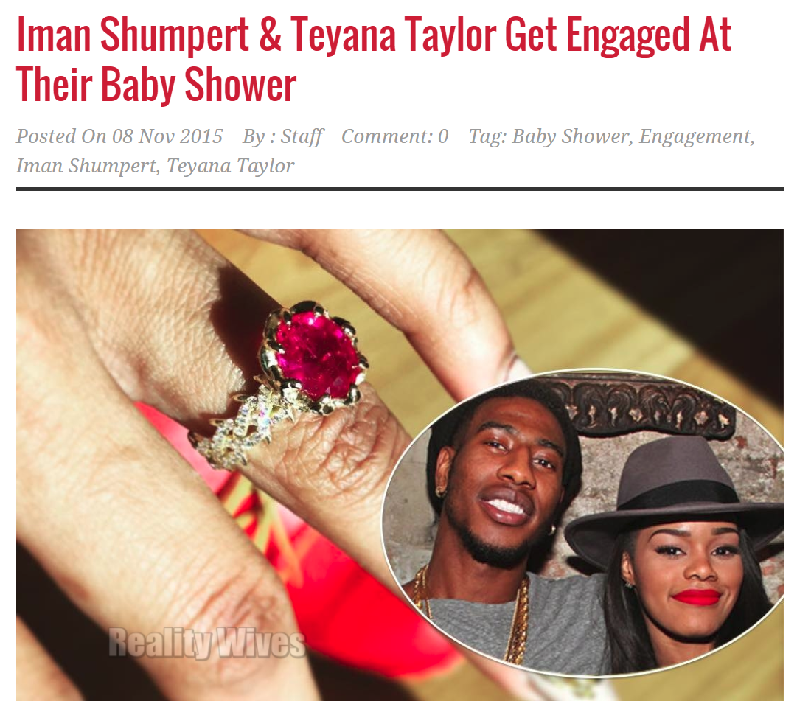
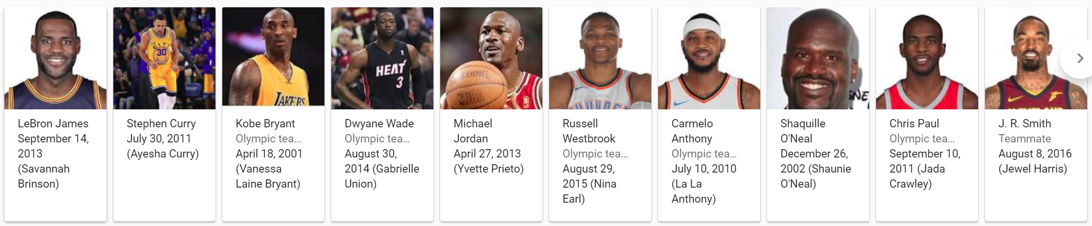
Players and their important dates
Source of information:
Twitter
Instagram
Google
Wikipedia
Notes:
Players with a lot media exposure, who’s willing to share their personal experiences
Sourcing with greatest player in history (the ones that even I know) they also have a lot of media coverage
The ones involved with the Kardashians, they’ve been through a lot….

Slide 3
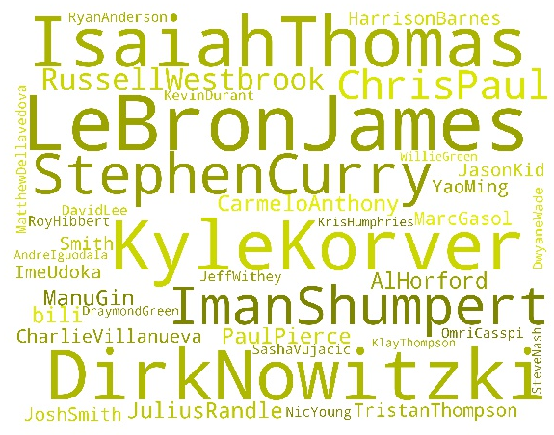
Summary of Dataset
Players in total: 38
Events in total: 78
Total Player 38 | Wedding | Engagement | Baby Born | Death of Family
Events 78 | 20 | 26 | 28 | 4
Word frequency plotted by Python package Word Cloud
One player can have multiple life events
Each new born baby is considered as an independent event

Slide 4
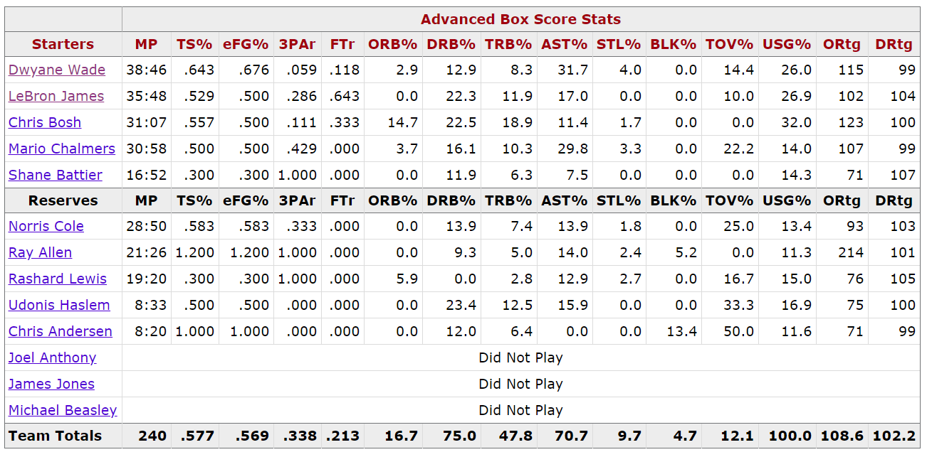
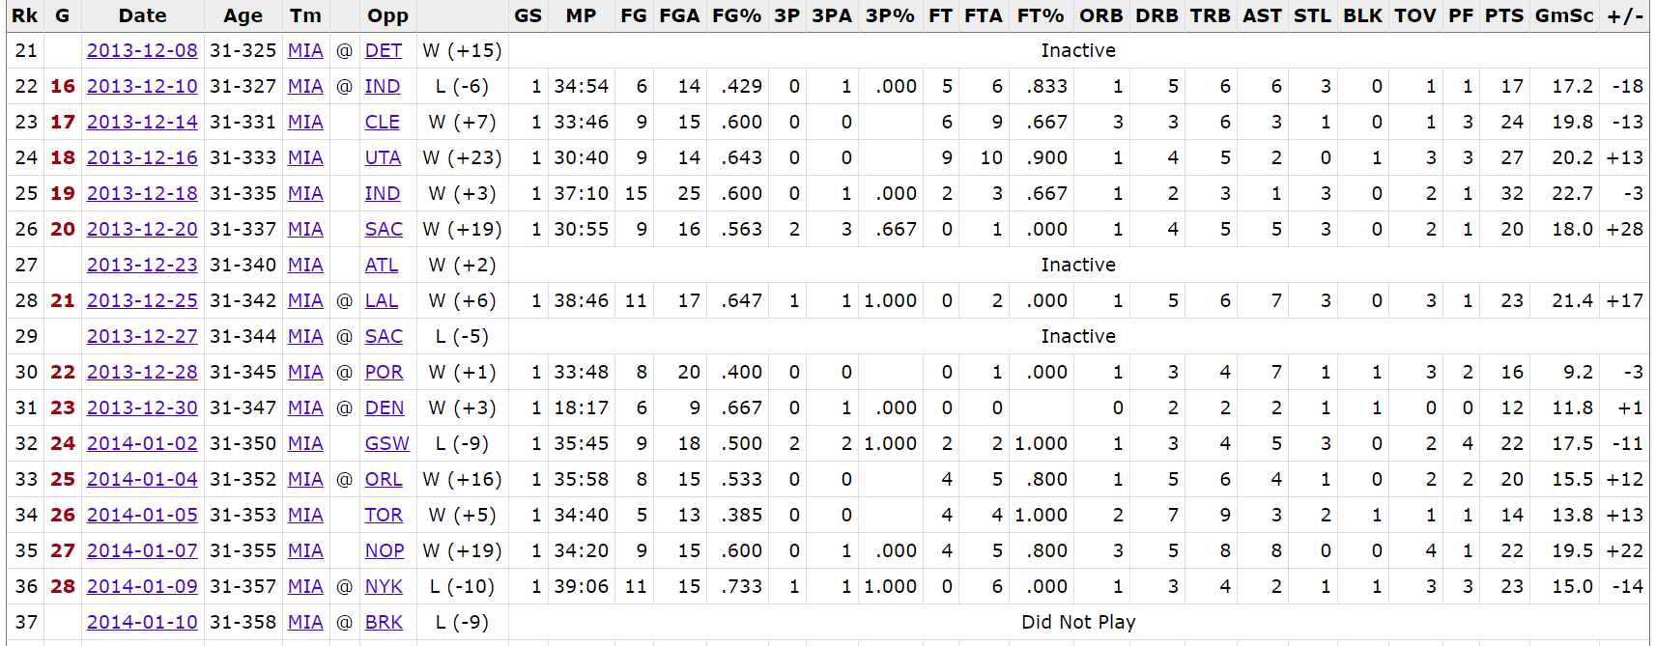
Statistical data
All statistical game data from https://www.basketball-reference.com/
Python package Beautiful Soup was used to acquire data
Games within one month before and after the event were included
Advance stats of each game were acquired as well
Game List
Advanced Game Stats

Slide 5
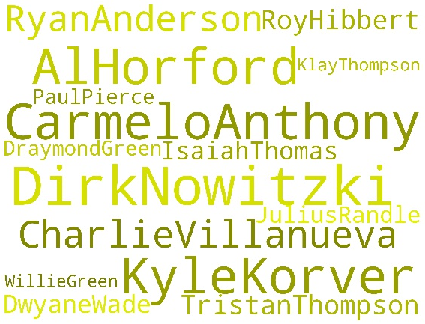
Parsing data
Total Player 38 | Wedding | Engagement | Baby Born | Death of Family
Events 78 | 20 | 26 | 28 | 4
Qualified Events 19 | 0 | 5 | 12 | 2
If a player did not play more than 3 games both before and after life event, his stats were excluded from the analysis, as he can’t provide reliable statistical data
A lot of life events were excluded because it happened out of season (no one got married in the middle of season)
Games with zero points from the player were excluded
19 events from 15 players left

Slide 6
Metrics for player performance
AST -- Assists
STL -- Steals
BLK -- Blocks
TOV -- Turnovers
PF -- Personal Fouls
Game Score Formula =
+ 1.0*(Points)
+ 0.4*(Field Goals Made)
- 0.7*(Field Goal Attempts)
+ 0.7*(Offensive Rebounds)
+ 0.3*(Defensive rebounds)
+ 1.0*(Steals)
+ 0.7*(Assists)
+ 0.7*(Blocked Shots)
- 0.4*(Free Throws Missed)
- 0.4*(Personal Fouls)
- 1.0*(Turnovers)
FG -- Field Goals
FGA -- Field Goal Attempts
FG% -- Field Goal Percentage
3P -- 3-Point Field Goals
3PA -- 3-Point Field Goal Attempts
3P% -- 3-Point Field Goal Percentage
FT -- Free Throws
FTA -- Free Throw Attempts
FT% -- Free Throw Percentage
ORB -- Offensive Rebounds
DRB -- Defensive Rebounds
TRB -- Total Rebounds
PTS -- Points
+/- -- Plus/Minus
GmSc -- Game Score

Slide 7

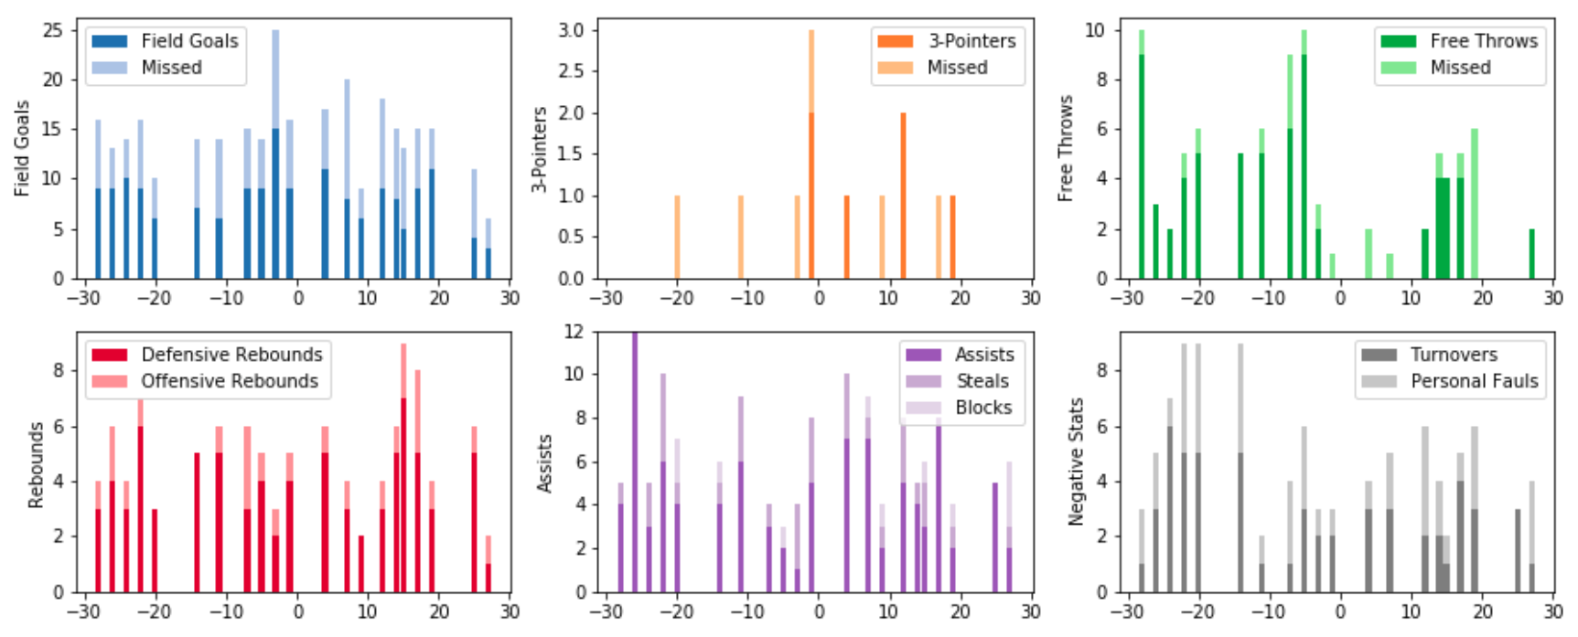
Dwyane Wade, around 12/21/2013 (Engagement)
*
*
Days
Days
Days
Is there significant change in these parameters?
Hard to tell

Slide 8
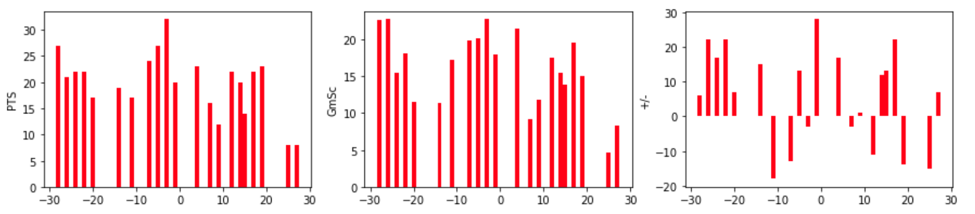
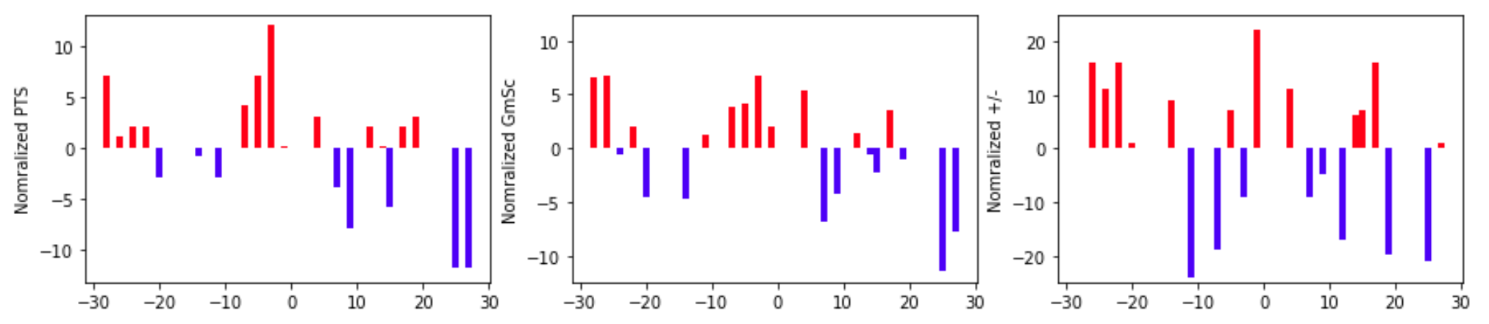
Dwyane Wade, around 12/21/2013 (Engagement)
* PTS
* GmSc
+/-
Points and GameScore reveals a significant change in performance before and after.
Notes:
Normalization was done in two month period, but it would be more reliable when normalizing across the season

Slide 9
Group Level Evaluation
Pairwise t-test of average of metric
p-value | Over all | Engage | Baby | Death of Family
PTS | 0.495 | 0.423 | 0.737 | 0.586
GmSc | 0.391 | 0.215 | 0.830 | 0.636
+/- | 0.133 | 0.167 | 0.447 | 0.254
ORtg | 0.718 | 0.333 | 0.476 | 0.035
DRtg | 0.000 | 0.002 | 0.015 | 0.231
P-value <0.05 is considered as statistically significant change
Insights:
Neither Points and Score reveals changes in performance at group level
The biggest limitation with the these two metrics are they do not factor in minutes played so therefore measure productivity but not efficiency.

Slide 10
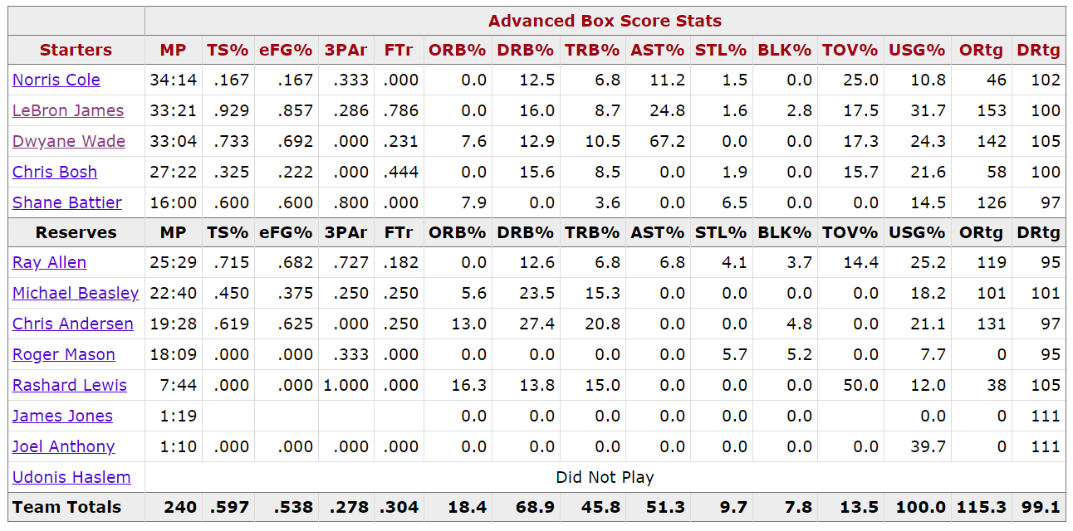
Offense and Defense Rating
The number of points produced or allowed by a player per hundred total individual possessions
In other words, 'How many points is a player likely to generate when he tries?'
Independent of duration on court, number of attempts or winning/lose of the game
Ideal metric for comparisons within and among players

Slide 11
Group Level Evaluation with OR and DR
Pairwise t-test of average of metric
p-value | Over all | Engage | Baby | Death of Family
PTS | 0.495 | 0.423 | 0.737 | 0.586
GmSc | 0.391 | 0.215 | 0.830 | 0.636
+/- | 0.133 | 0.167 | 0.447 | 0.254
ORtg | 0.718 | 0.333 | 0.476 | 0.035
DRtg | 0.000 | 0.002 | 0.015 | 0.231
P-value <0.05 is considered as statistically significant change
Interpretation: Players maintain the same ability of scoring before and after the life experience event, however their ability of preventing the scoring for the opponent team have significantly decrease

Slide 12
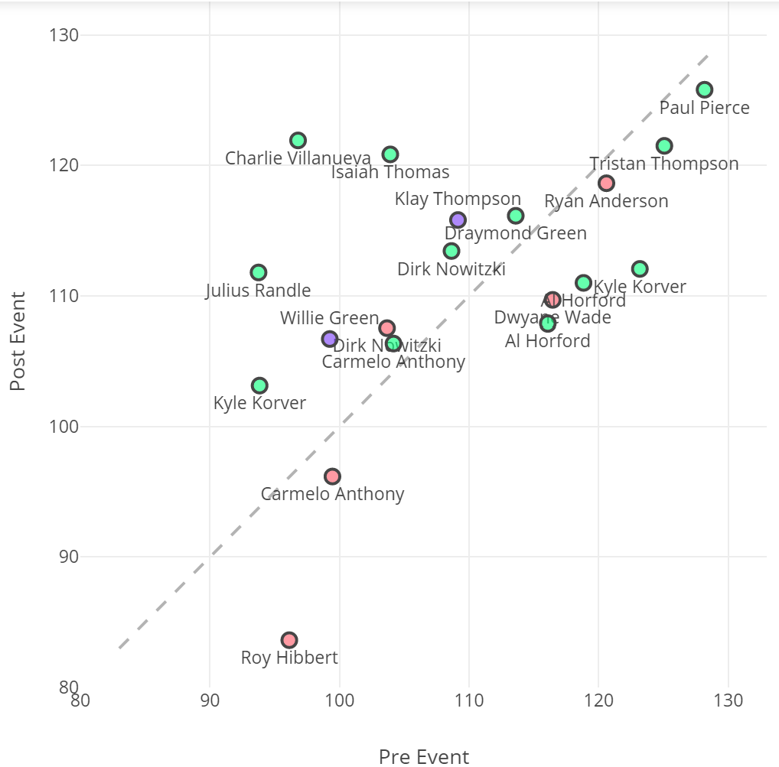
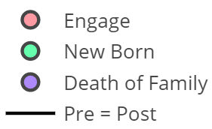
Offensive Rating
Performance Increase
Even though no statistically significant change was found at overall group level, sub-groups had different trend
Most players in the Engagement group have decreases in Offensive Rating after the life event, except for Nowitzki
All the players who just experienced family tragedy have a boost in their offensive ability
The impact of new born baby is diverse, however positive influence is more dominant
Performance Decrease

Slide 13
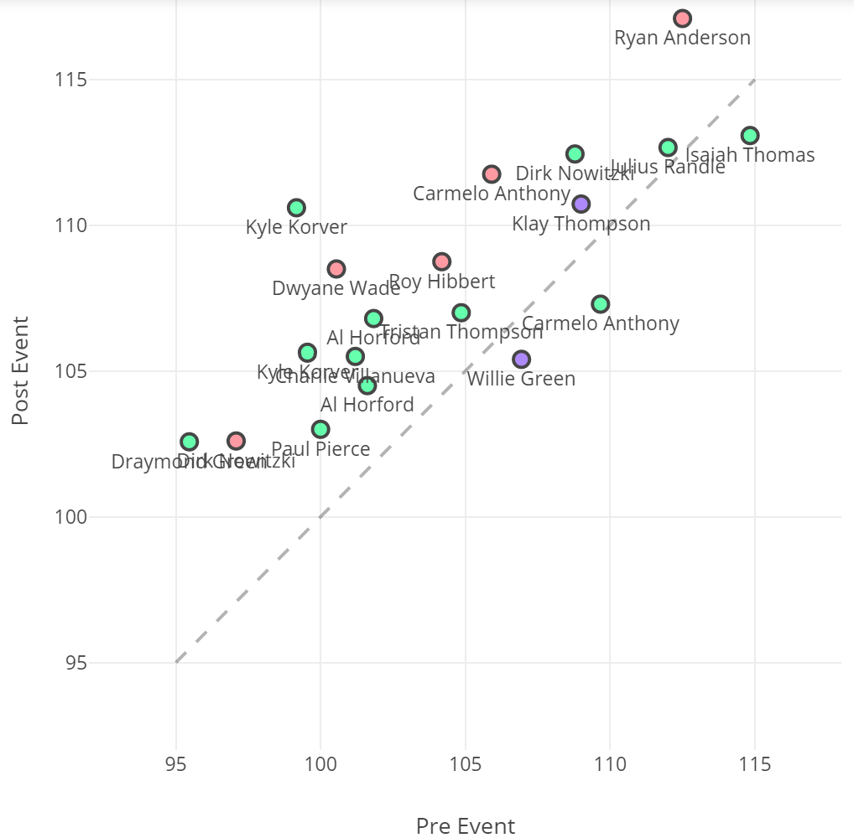
Defensive Rating
Defensive Rating increment suggests reduction in performance that are related to defense.
Overall, life experiences have a significantly negative impact on players’ defensive ability.
The trends for each sub-group are quite consistent.
The results from recent death in family group are not conclusive due to small number of sample.
Performance Decrease
Performance Increase

Slide 14
Performance Variation
Pairwise t-test of standard deviation of metric
 | Over all | Engage | Baby | Death of Family
PTS | 0.710 | 0.283 | 0.447 | 0.704
GmSc | 0.922 | 0.326 | 0.945 | 0.701
+/- | 0.626 | 0.398 | 0.923 | 0.711
ORtg | 0.653 | 0.346 | 0.558 | 0.898
DRtg | 0.792 | 0.539 | 0.952 | 0.736
Motivation:
With similar level of performance in average, I want to investigate on the variability of players’ performance before and after life events.

Slide 15
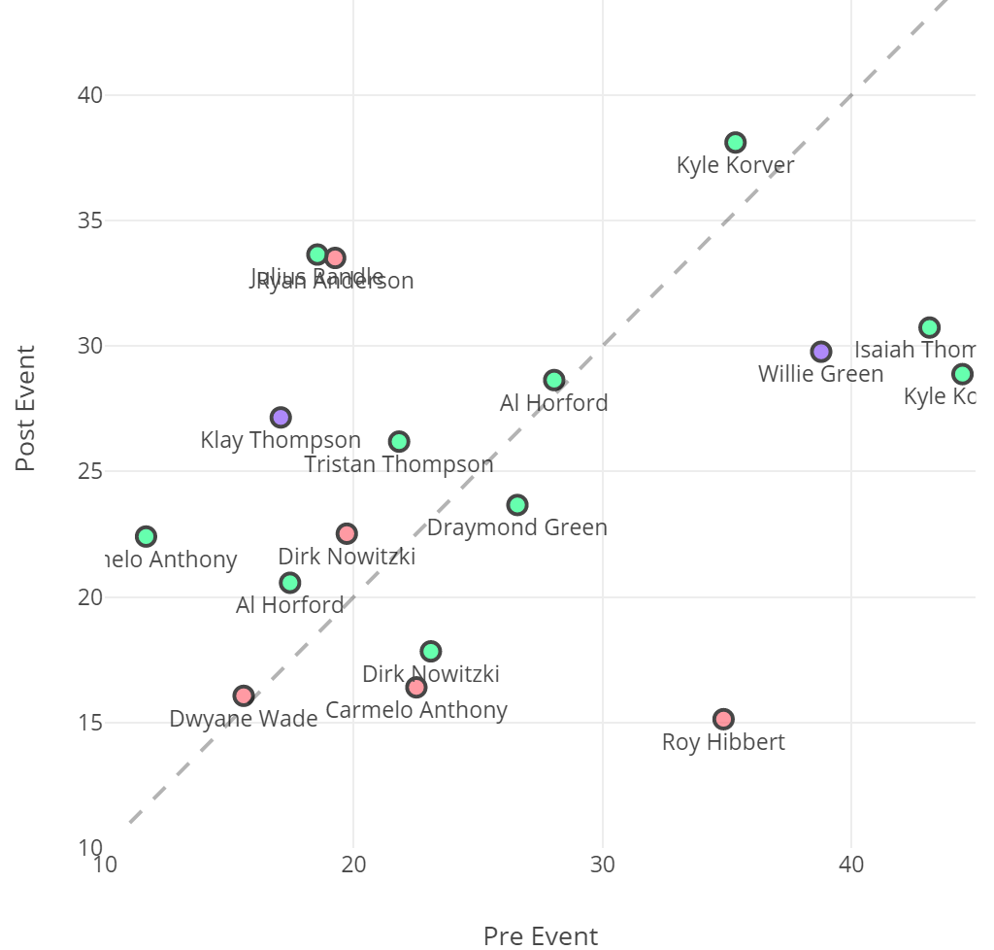
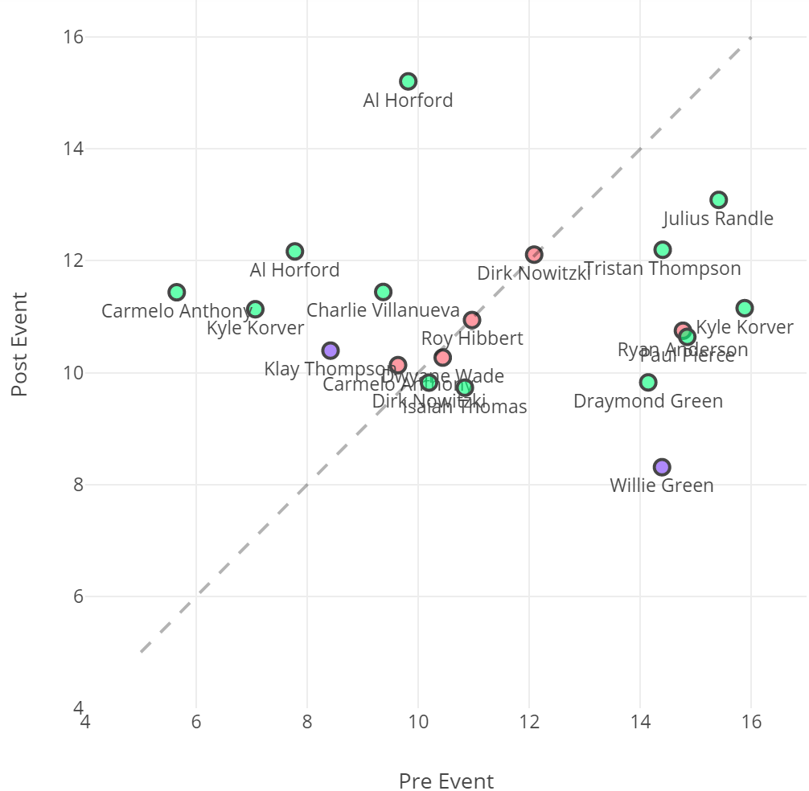
Performance Variation
Offensive Rating
Defensive Rating
However, no statistically significant change was found.

Slide 16
Other Considerations
The team and opponent’s performance need to be accounted for. Team’s Offensive and Defensive Ratings are good metrics.
Comparing post-event performance with seasonal or event longer duration statistics might have a clearer view of the changes
Other metrics:
Player Impact Estimate
Usage Percentage
Efficiency

Slide 17
References
http://stats.nba.com/
http://www.nbaminer.com/
https://www.nbastuffer.com/
http://www.rustylarue.com/more-than-94/player-efficiency-stats
https://www.basketball-reference.com/

